Slide 1



Malware Detection of Android Platform Based On Machine Learning

Slide 2

Contents
Introduction
Motivation
Contribution 1: A Multimodal Malware Detection Technique for Android IoT Devices Using Various
Contribution 2: Research on Data Mining of Permission-Induced Risk for Android IoT Devices
Conclusion and Future Work
Background
Problem Statement

Slide 3

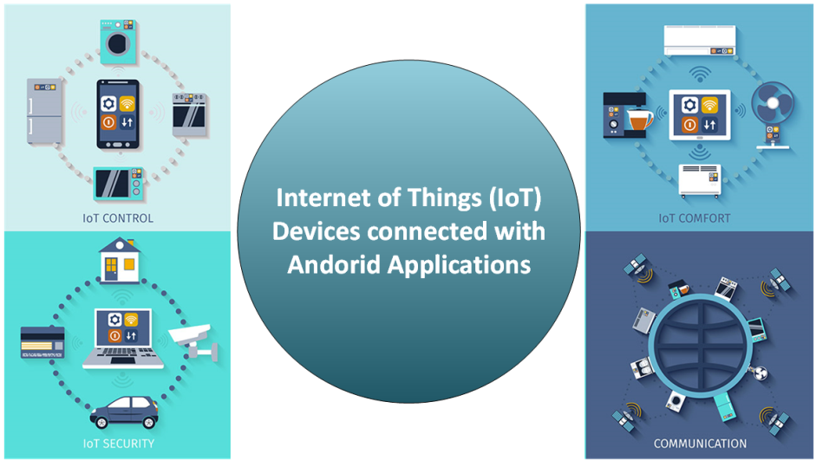
Introduction
With the growing era of the Internet of Things (IoT), more and more devices are connecting with the Internet
A secure malware detection mechanism is required to increase the security of the application.
Recently, there is a rapid increase in threats and malware attacks on Android-based devices.
Due to extensive exploitation of the Android platform in the IoT devices creates a task challenging of securing such kind of malware activities,

Slide 4
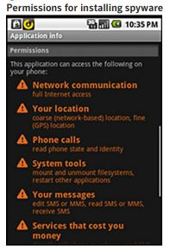
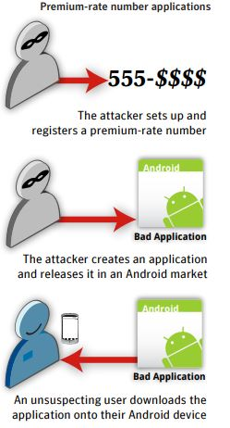
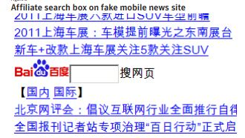
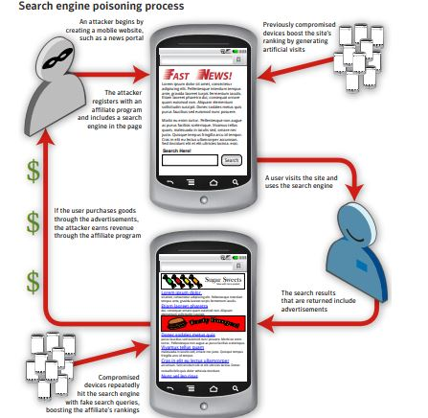
Motivation
Spyware
Stealing mobile transaction
Pay-per-click
Search engine poisoning
Web phishing links
Premium-rate number

Slide 5
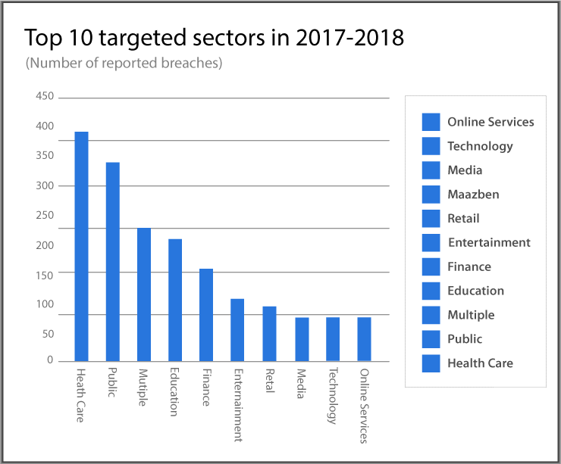
Motivation

Slide 6
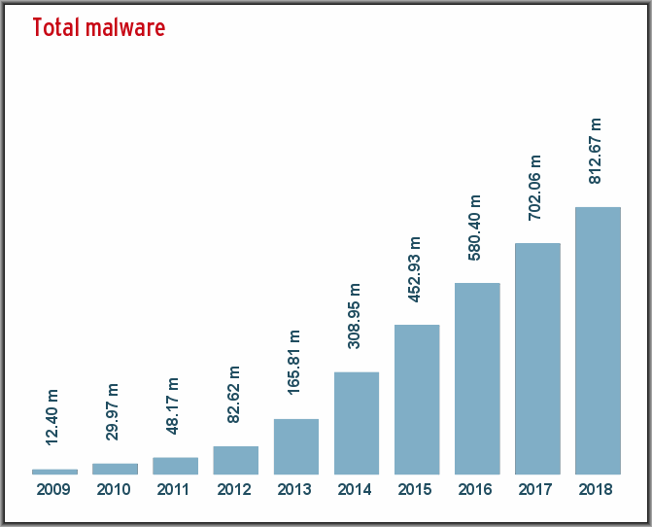
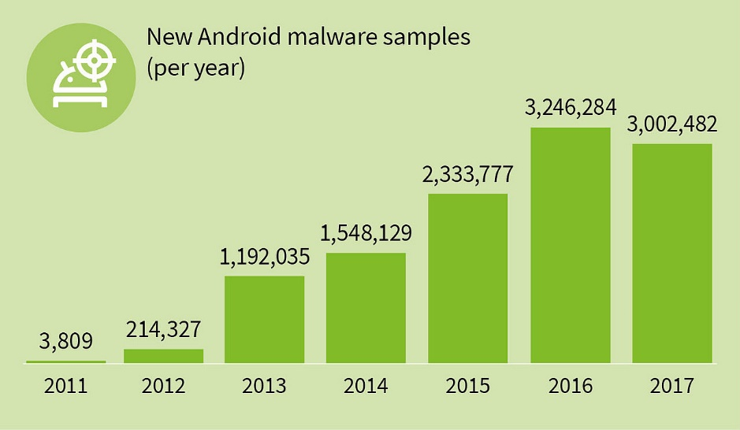
Motivation
According to a recent study, a malicious Android application is developed almost every 10 s

Slide 7
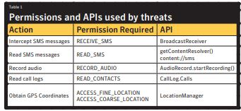
Motivation
Premium-rate number billing scams
Spyware
Search engine poisoning
Pay-per-click scams
Pay-per-install schemes
Adware
Stealing mobile transaction authentica¬tion numbers (mTAN)

Slide 8
Problem Statement
A big challenge of security and privacy of the end users
It is difficult to detect malicious activities through traditional methods
Most of the previous studies proposed for Android malware detection were based on the limited types of feature selection to detect malware [5], [6], [14]–[18].
Most of existing malware detection methods cannot be directly employed for IoT
1) Computation complexity 2) limited resources i.e. cost, memory, processing capabilities [5], [6], [14]–[18].

Slide 9

Research Objectives
To develop framework that combines the advantages of
Both machine learning techniques and blockchain technology to improve the malware detection for Android IoT devices
To develop a novel approach to distinguish between malware and benign applications based on risky permissions of Android
To improve the accuracy of machine learning alg
orithms regarding malware detecting, such as random forest and clustering

Slide 10
Background
STATIC ANALYSIS
DYNAMIC ANALYSIS
HYBRID ANALYSIS

Slide 11
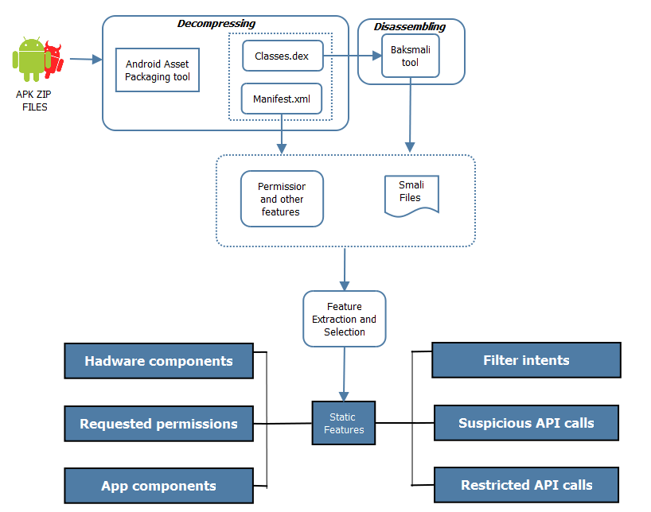
Background
STATIC ANALYSIS

Slide 12
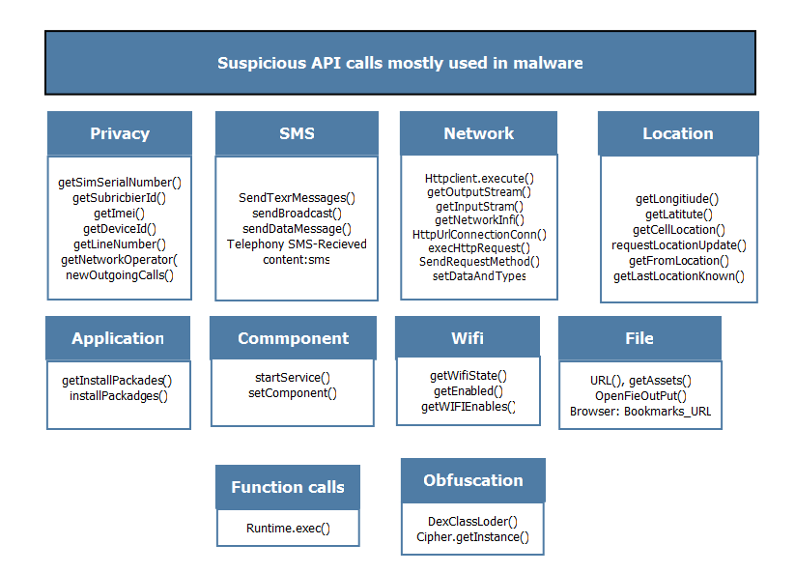
Background
STATIC ANALYSIS (Suspicious API Calls)

Slide 13
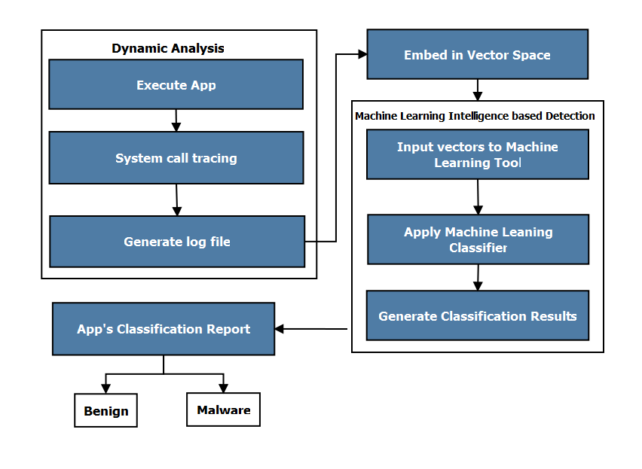
Background
DYNAMIC ANALYSIS

Slide 14
Background
DYNAMIC ANALYSIS

Slide 15
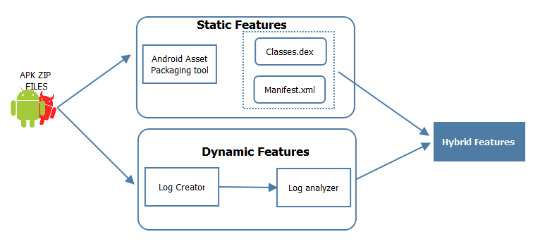
Background
HYBRID ANALYSIS

Slide 16
Contribution 1
1. Experiment and Results
A novel framework was proposed that combines the advantages of both
Machine learning techniques
Blockchain technology
To improve the malware detection for Android IoT devices
The proposed technique is implemented using a sequential approach, which includes
Clustering, classification, and blockchain
The proposed framework runs in recurring way described as follows:
Hackers create a new type of malware
Machine learning identify the malware and re-train the model
The new type of malware information stores in the blockchain database
Rajesh Kumar, Xiaosong Zhang, and Abubakar Sharif, “A Multimodal Malware Detection Technique for Android IoT Devices Using Various Features by combining machine learning and blockchain technology”, IEEE Access, 2019 (impact factor =3.557, rank 2)
.

Slide 17
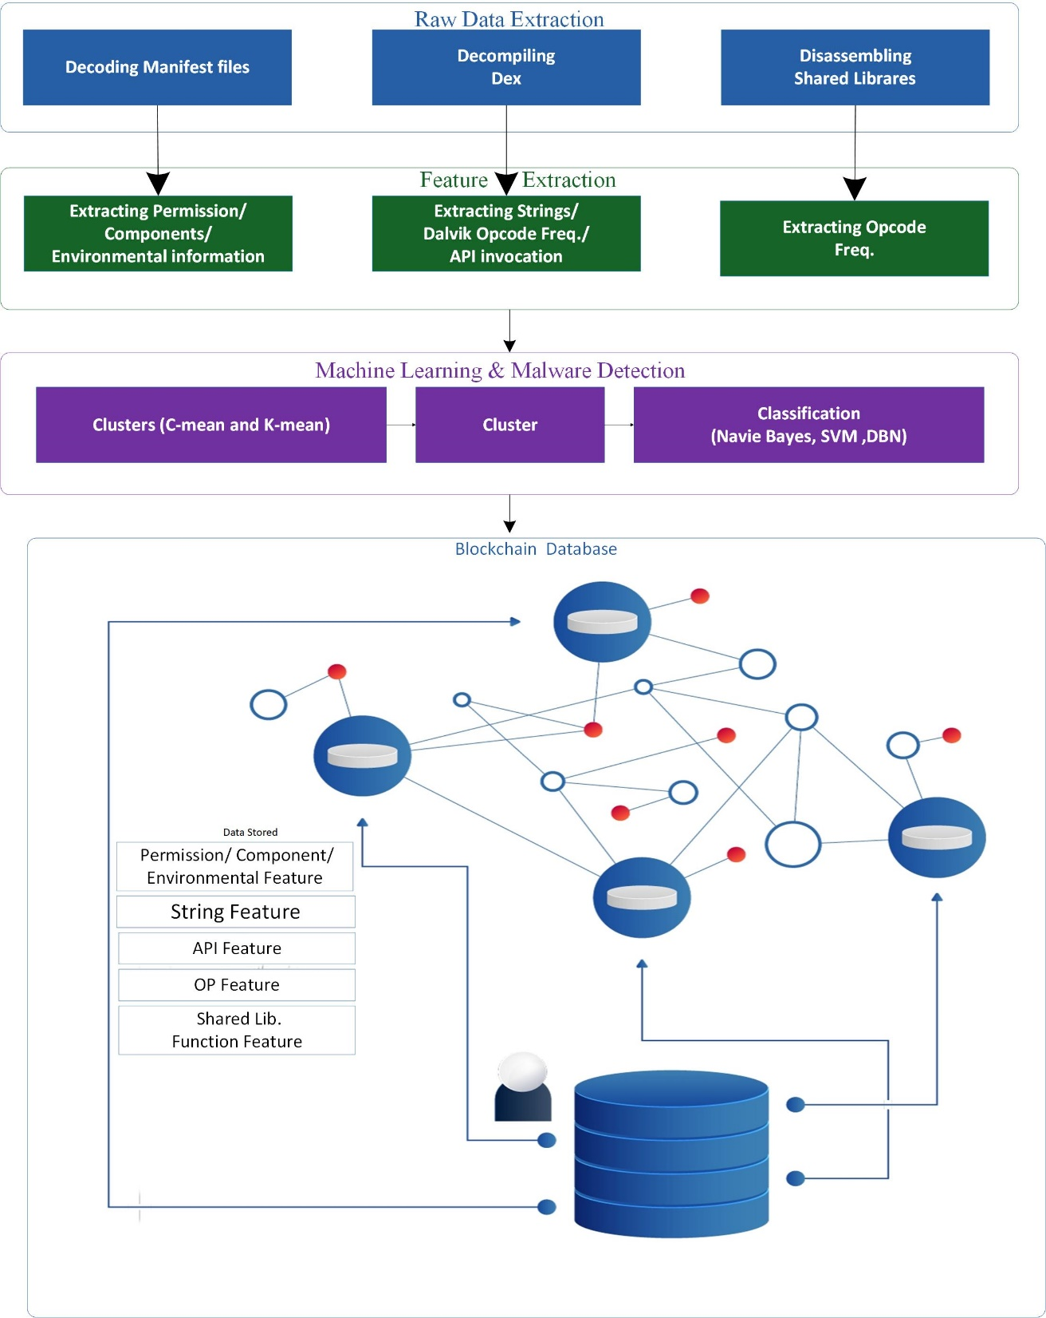

Slide 18
Proposed Framework
The proposed framework runs in recurring way described
in following three steps as follows:
1) Hackers create a new type of malware.
2) Machine learning identify the malware and re-train the model.
3) The new type of malware information stores in the blockchain database.
machine learning technique provides an efficient approach to train the model
It stores and exchanges the trained model results throughout the blockchain network for spreading the information of newly generated malware.
Proposed framework holds the information about the new types of malware. So, the shared database can control new types of malware and secure devices

Slide 19
Modified Clustering Algorithm
calculating the weights for each feature set
A
developing a parametric study for optimization
B
Clustering
iterative reduction of unnecessary features having small weights
C

Slide 20
Clustering
Modified Clustering Algorithm
The clustering method calculates the weights of each feature set and iterative reduced the unnecessary features
It can effectively distinguish malware and benign applications even though malware have many properties similar to benign applications
Calculate weights
Distinguish Malware and Benign
The proposed clustering method handles multidimensional data by reducing the features using weight learning procedure.
Multidimensional data
Applying many types
This property enables proposed clustering method to fit for applying on many types of clustering problems
Example
For example, it can be applied on image recognition, cell formation, topic identification, text summarization and many more

Slide 21
Modified Clustering Algorithm
The proposed algorithm for removing unnecessary features.
The similarity-based features are extracted from the API and Opcode features
Firstly, we normalized the values in the range of [0,1].
After that, we measure the distance of malicious features
calculating the minimum distance among various features
To avoid the irrelevant features and improve the performance, we select the small weights for the feature reduction

Slide 22
Naïve Bayes Classifier for Multi-Class
1
Multi-feature Naive Bayes algorithm for classification of malware
2
it extracts the most vital characteristics of input matrix for removing noisy objects from the data
3
It extract more important features to provide classification and regression that achieves high accuracy and robustness

Slide 23
Figure 4- 4 Flow Chart of Algorithm

Slide 24
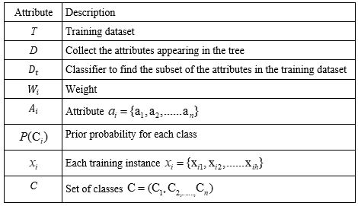
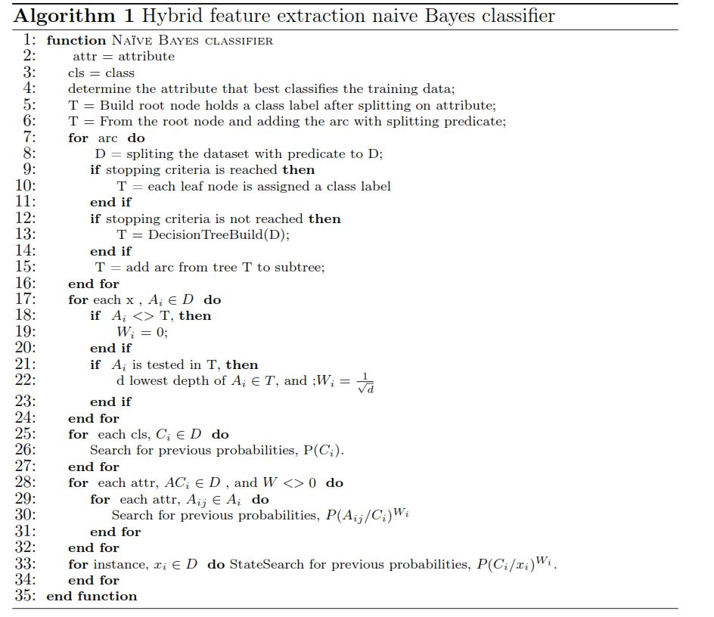
Naïve Bayes Classifier for Multi-Class
we propose a multi-feature Naive Bayes algorithm for classification of malware.
Naive Bayes is the most suitable classification approach for various types of features.
It extracts the most vital characteristics of input matrix for removing noisy objects.
Figure 4- 4 Flow Chart of Algorithm

Slide 25
Blockchain Technology
To store authentic information of extracted features in a distributed malware database blocks
To increase the run-time detection of malware with more speed and accuracy
Blockchain
To announce malware information for all users
To protect the user from malicious apps
proposed framework can identify the new type of malware for IoT devices

Slide 26
Blockchain Based Framework for
Android Malware Detection
The overall architecture consist four layer:
Network Layer
Storage Layer
Support Layer
Application Layer
This design scheme cost-creditable for the IoT devices for malware detection.
The network layer Link nodes can communicate through a P2P connection between devices. The blockchain can store the malware features of malicious code in the storage layer.
Furthermore, the support layer of the Android platform used blockchain technology for data encryption, access control, and key management, etc
Application layer blockchain technology protect the user from malicious applications.
The advantage of using the blockchain technology is to identify illegal activity and illegal manipulating of the user's data.
Figure 4- 4 Flow Chart of Algorithm

Slide 27
Blockchain Based Framework for
Android Malware Detection
programs and interfaces for
various applications are provided
Users can interact with various applications without considering details about the bottom technology of the blockchain.
Typical applications include the malware detection, the malicious event detection the evidence tracking and extraction, and the digital storage applications.
Application
Layer
The consensus mechanism determines the legitimacy of nodes in the Consortium Blockchain
conrms the submitted information ensures the legality and validity of block information in the database.
The digital signature makes the data
submitted by users undeniable, and makes the blockchain capable of keeping the user who submits the illegal data.
Support Layer
features of malicious codes are stored.
Factual information is also provided in this layer to form a
distributed malware fact-base in the Consortium Blockchain.
Each block contains a page of malware features and other
information, including block head and block data.
Once these blocks are conrmed, they cannot be modied.
...
Storage Layer
Network Layer
Network Layer provides data exchange reliability i.e. data Android platform used blockchain technology for data encryption, access control, and key management, etc
Figure 4- 4 Flow Chart of Algorithm

Slide 28
Blockchain Based Framework for
Android Malware Detection
The advantage of using the blockchain technology is to identify illegal activity and illegal manipulating of the user's data.
Figure 4- 4 Flow Chart of Algorithm

Slide 29
Blockchain Based Framework for
Android Malware Detection
Keywords | Size | Definition
Pre- Hash | 32 bytes | preceding block hash value
Version number | 4 bytes | track the protocol or software updates
Timestamp | 5 bytes | records the time a block
Transaction_count | 15 bytes | number of malware results in the current block
Merkle root | 32 bytes | it calculate the malicious codes which detected by block
Nonce | 15 byte | randomly recognized as a formal block
The block mainly composed of two section:
Block head
Block Data
The block head describes the information of the blocks which can store the Markle root, hash value, version number.
Figure 4- 4 Flow Chart of Algorithm

Slide 30
Blockchain Based Framework for
Android Malware Detection
Keywords | Size | Definition
Pre- Hash | 32 bytes | preceding block hash value
Version number | 4 bytes | track the protocol or software updates
Timestamp | 5 bytes | records the time a block
Transaction_count | 15 bytes | number of malware results in the current block
Merkle root | 32 bytes | it calculate the malicious codes which detected by block
Nonce | 15 byte | randomly recognized as a formal block
The block mainly composed of two section:
Block head
Block Data
The block head describes the information of the blocks which can store the Markle root, hash value, version number.
Figure 4- 4 Flow Chart of Algorithm

Slide 31
Figure 4- 4 Flow Chart of Algorithm

Slide 32
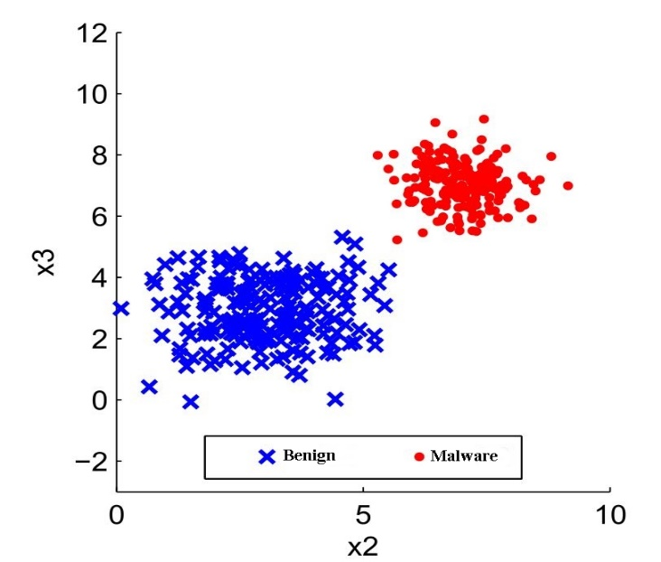
Experiment and Results
Clustering Results
 | Original Label | Merged Label | Benign and Malware Label
String | 89.10% | 89.10% | 95.05%
API freq | 96.53% | 97.72% | 99.36%
Shared Lib.Opcode | 75.47% | 99.38% | 98.88%
Manifest | 61.50% | 65.43% | 78.55%
Opcode freq | 73.65% | 76.39% | 91.88%

Slide 33
Experiment and Results
Classification Results

Slide 34
Experiment and Results

Slide 35
Compression accuracy with other works
Authors | Algorthim | Capicity for feature diversity | Accuracy | F-measure
OURs | Proposed NB | High | 98% | 0.98
^{[142]} | DNN/RNN | medium | 90% | NA
^{[143]} | CNN | low | 90% | NA
^{[144]} | XGBoost | low | 97% | 0.97
^{[27]} | Adaboost/ NB/ DT | Low | N.A | 0.78
^{[145]} | NB | low | 93% | NA
^{[13]} | SVM | low | 93.9 | NA
^{[146]} | KNN+Kmeans | low | NA | 0.91
^{[147]} | Bayesian | low | 92% | NA
^{[148]} | SVM | low | NA | 0.98
^{[149]} | RF | low | 97.5% | NA
Authors | Benign | Malware
OURs | 6192 | 5560
^{[27]} | 480 | 124769
^{[22]} | 45 | 300
^{[140]} | 5264 | 12026
^{[141]} | 378 | 324658
^{[34]} | 3978 | 500
^{[33]} | 175 | 621
^{[32]} | 1446 | 2338
^{[13]} | 5560 | 123453
^{[10]} | 2925 | 3938
^{[35]} | 238 | 1500

Slide 36

Summary
This research work proposes a framework that combines blockchain and machine learning for effective malware detection of Android IoT devices.
A
The malware information was extracted using machine learning techniques such as clustering and classification, and further this information was stored into the blockchain.
B
Thereby, all malware information stored in the blockchain history can be communicated through the network, and therefore any latest malware can be detected effectively
C
INFOGRAPHIC
D
OPTION

Slide 37
Contributions 2
A novel approach for malware detection based on permission ranking, similarity-based permission feature selection, and association rule for permission mining
The enhancement of the random forest algorithm to improve the accuracy for malware detection
Rajesh Kumar, Xiaosong Zhang, and Abubakar Sharif “Research on Data Mining of Permission-Induced Risk for Android IoT Devices” Applied Sciences Journal MDPI (SCI Journal,), 2019, 9(2), 277 , (impact factor =1.68, rank 3)

Slide 38
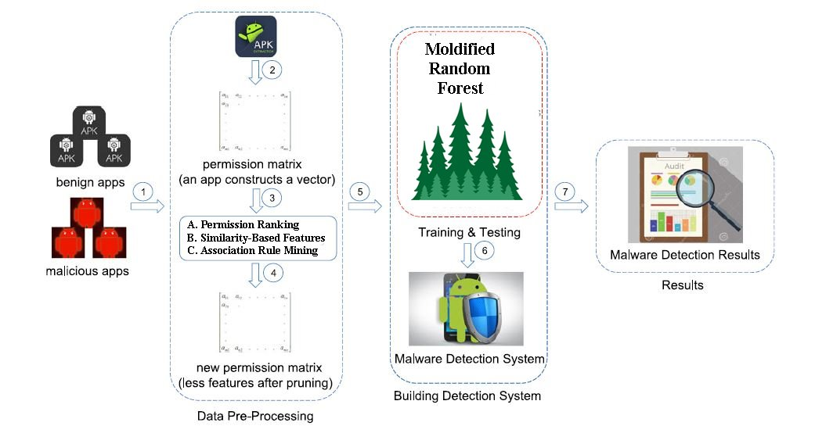
Proposed Framework

Slide 39
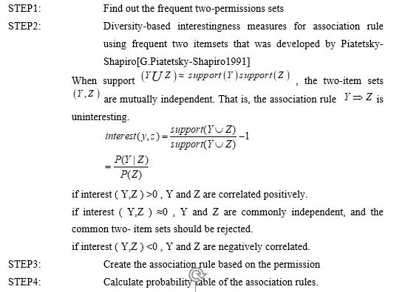
Proposed Methodology
Proposed Methodology
1- Permission Ranking:
Each permission defines a specific action that the application is permitted to perform. For example, the permission INTERNET specifies the user can access the Internet.
2- Similarity-Based Feature Selection:
Similarity of permission shown in the equation
Calculate the similarity between features
3- Association Rule Mining Algorithm
Association rule mining is used to discover meaningful relationships between variables in huge databases.
we found that many permission are always together i.e., READ_CONTACTS and WRITE CONTACTS are always used together.
we know that those permission always together.
we only need one of them to characterize certain behaviour.

Slide 40

Proposed Methodology (Modified RF)
Improved Random Forest
The performance of random forest algorithm was enhanced by iteratively remove the unnecessary features
By setting the upper limit on the number of trees in the random forest improve the accuracy and recall rate
Each decision tree is given the same weight, ignoring the difference between the strong classifier and the weak classifier, and affecting the overall classification performance

Slide 41
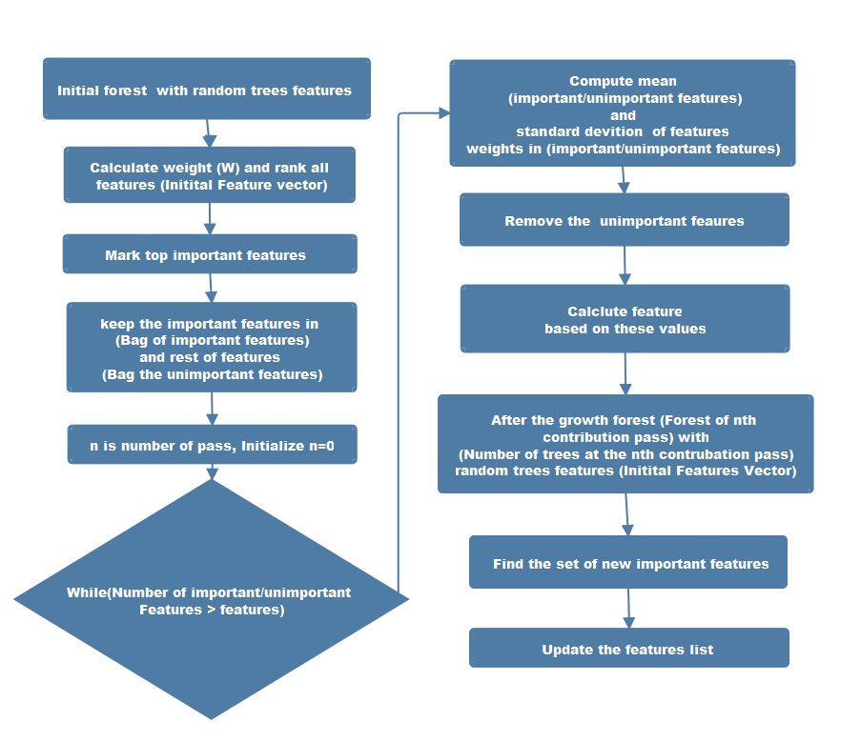
Proposed Methodology (Modified RF)

Slide 42
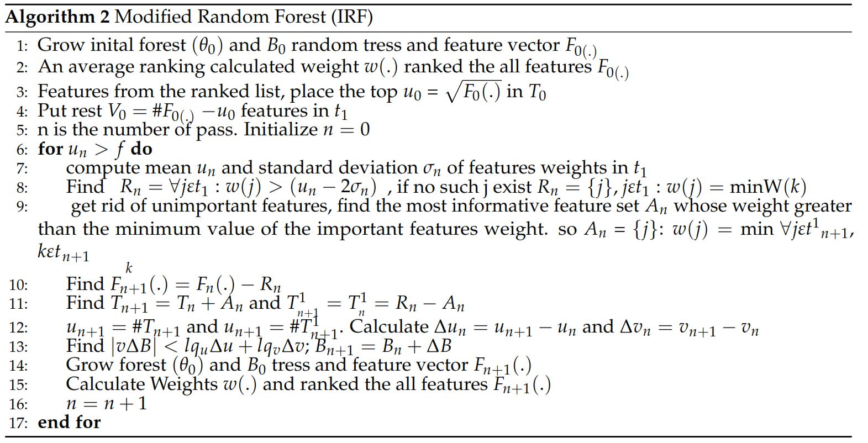
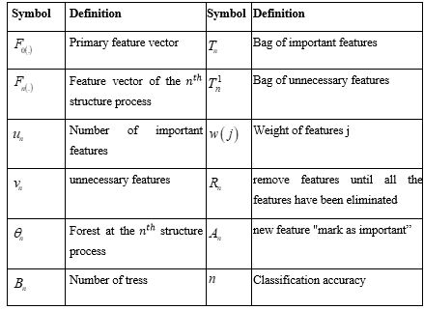
Proposed Methodology (Modified RF)
Changed the few parametrs of the random forest algorithm
line no 13 and 14 we tuned the parameters. in line no 13.
Removed the extra features and improved the more performance in feature selection.
Previous research ^{[26][31][32][55]} shows the Random Forest achieved the best performance in detection of malware application. Therefore, we modify the Random Forest algorithm to achieve better accuracy as compared with a simple Random Forest algorithm. The result shows that the proposed malware detection approach can effectively detect malware with more accuracy (98.1%).

Slide 43
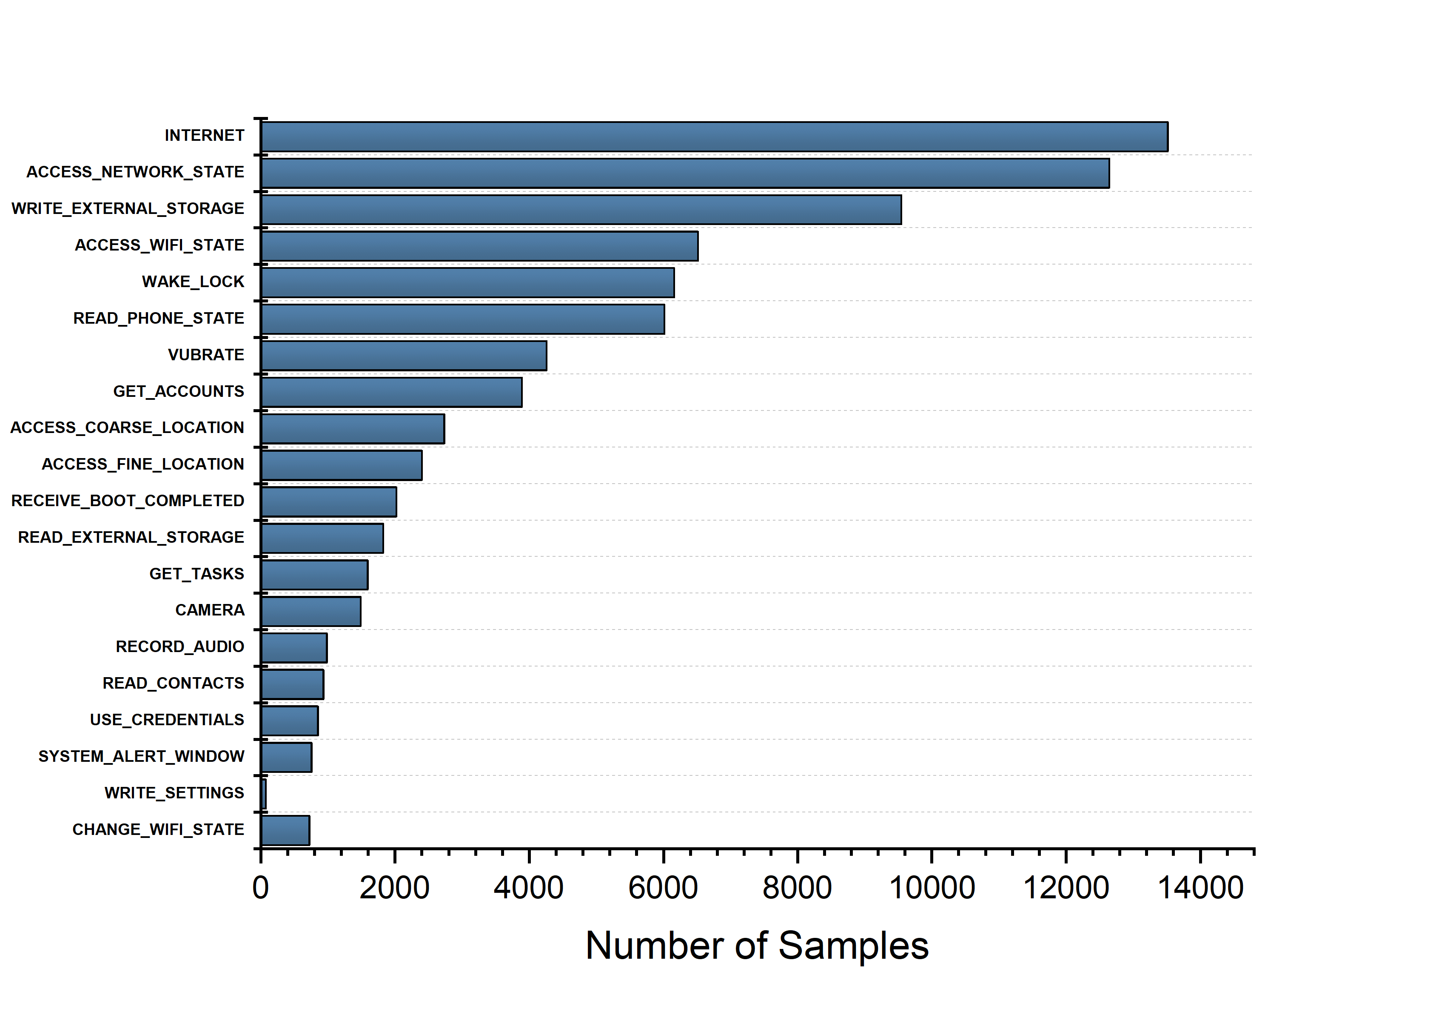
Frequency of Top Used Permission in Dataset

Slide 44
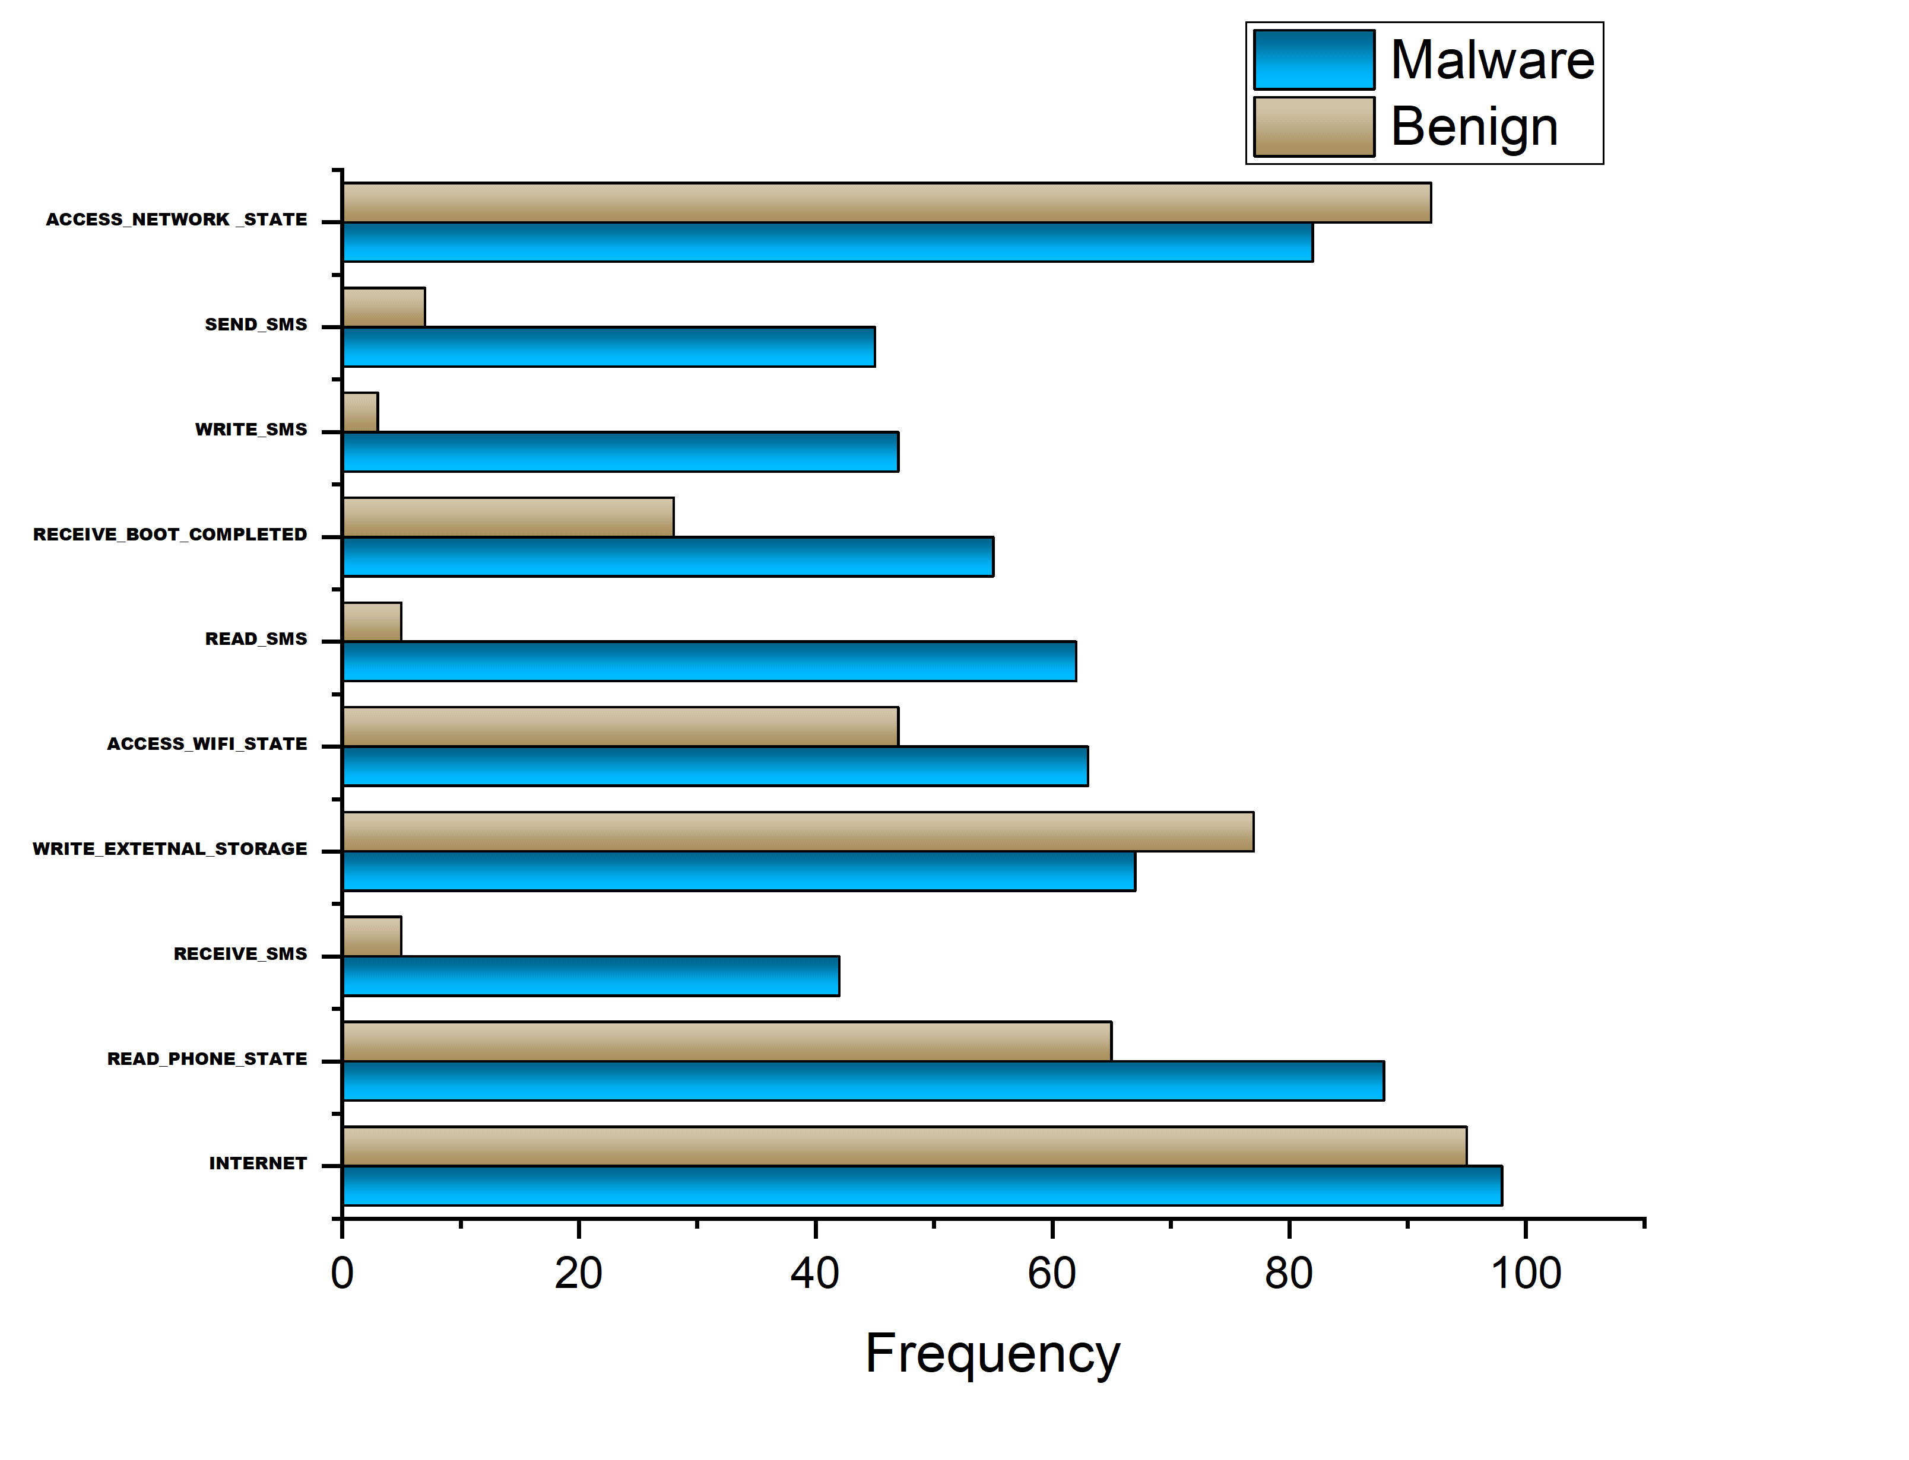
Frequency of Malware and Benign

Slide 45
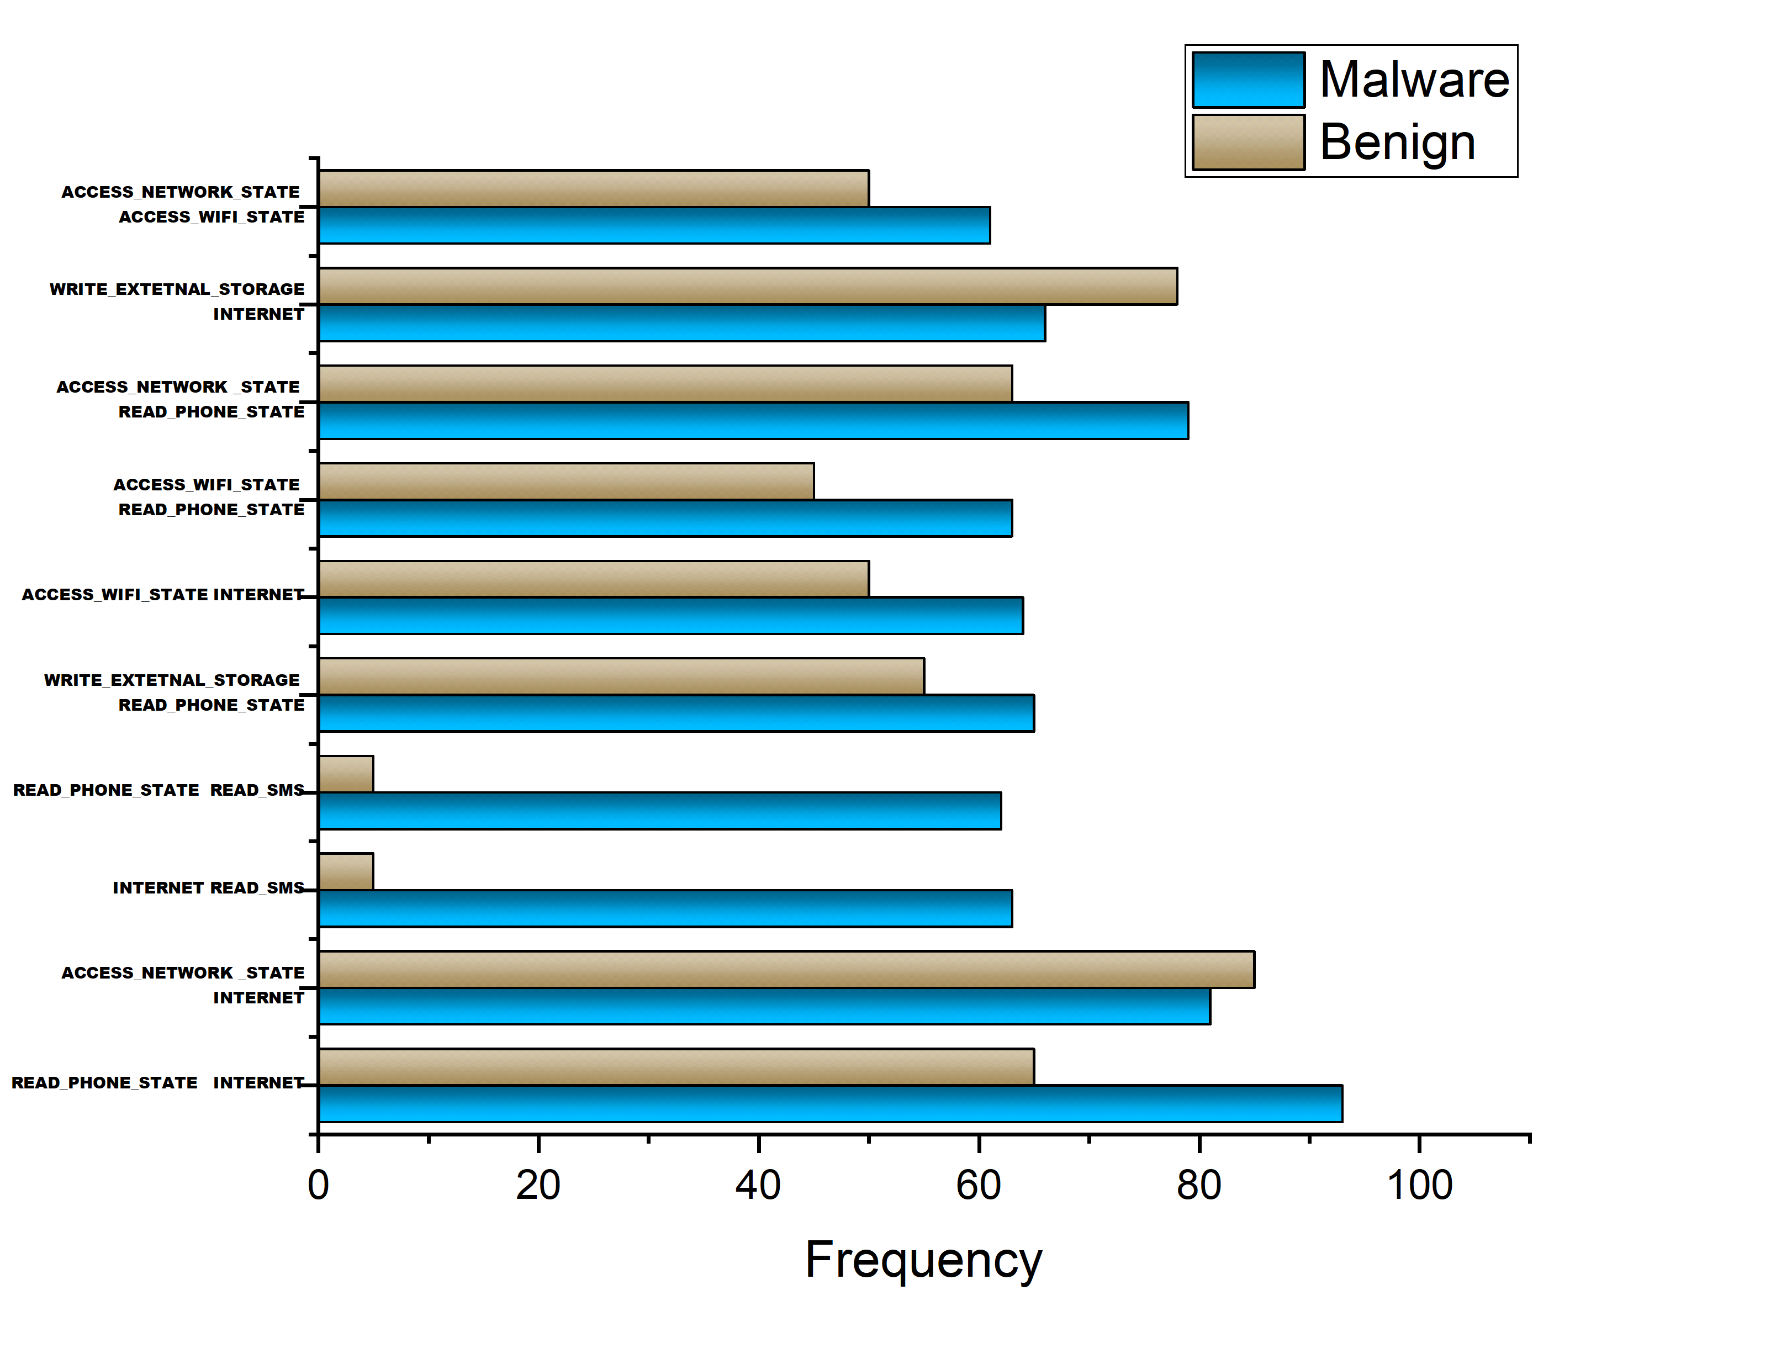
?????

Slide 46
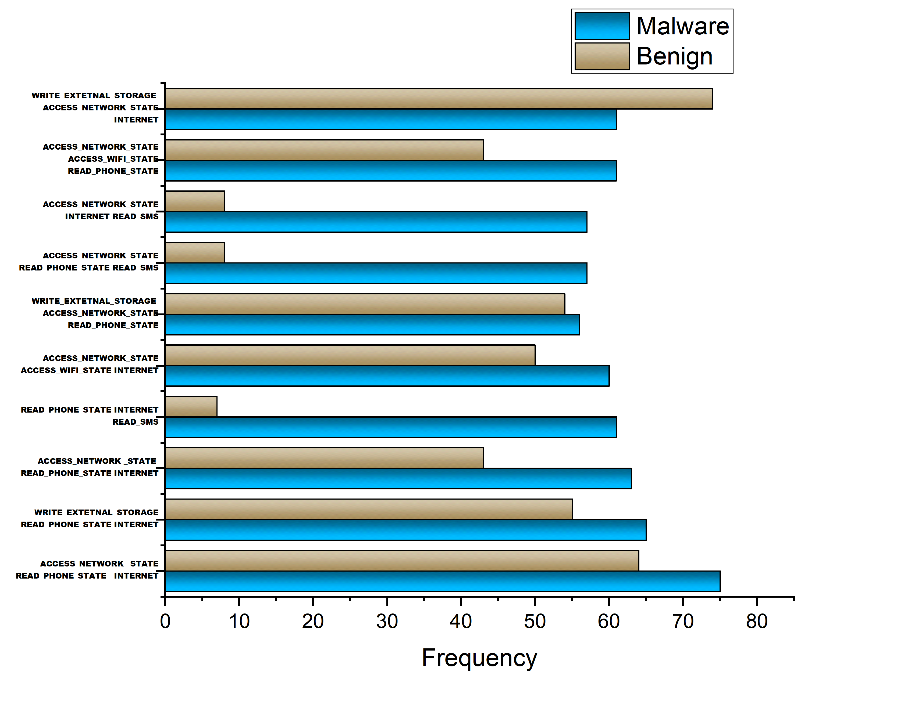
?????

Slide 47
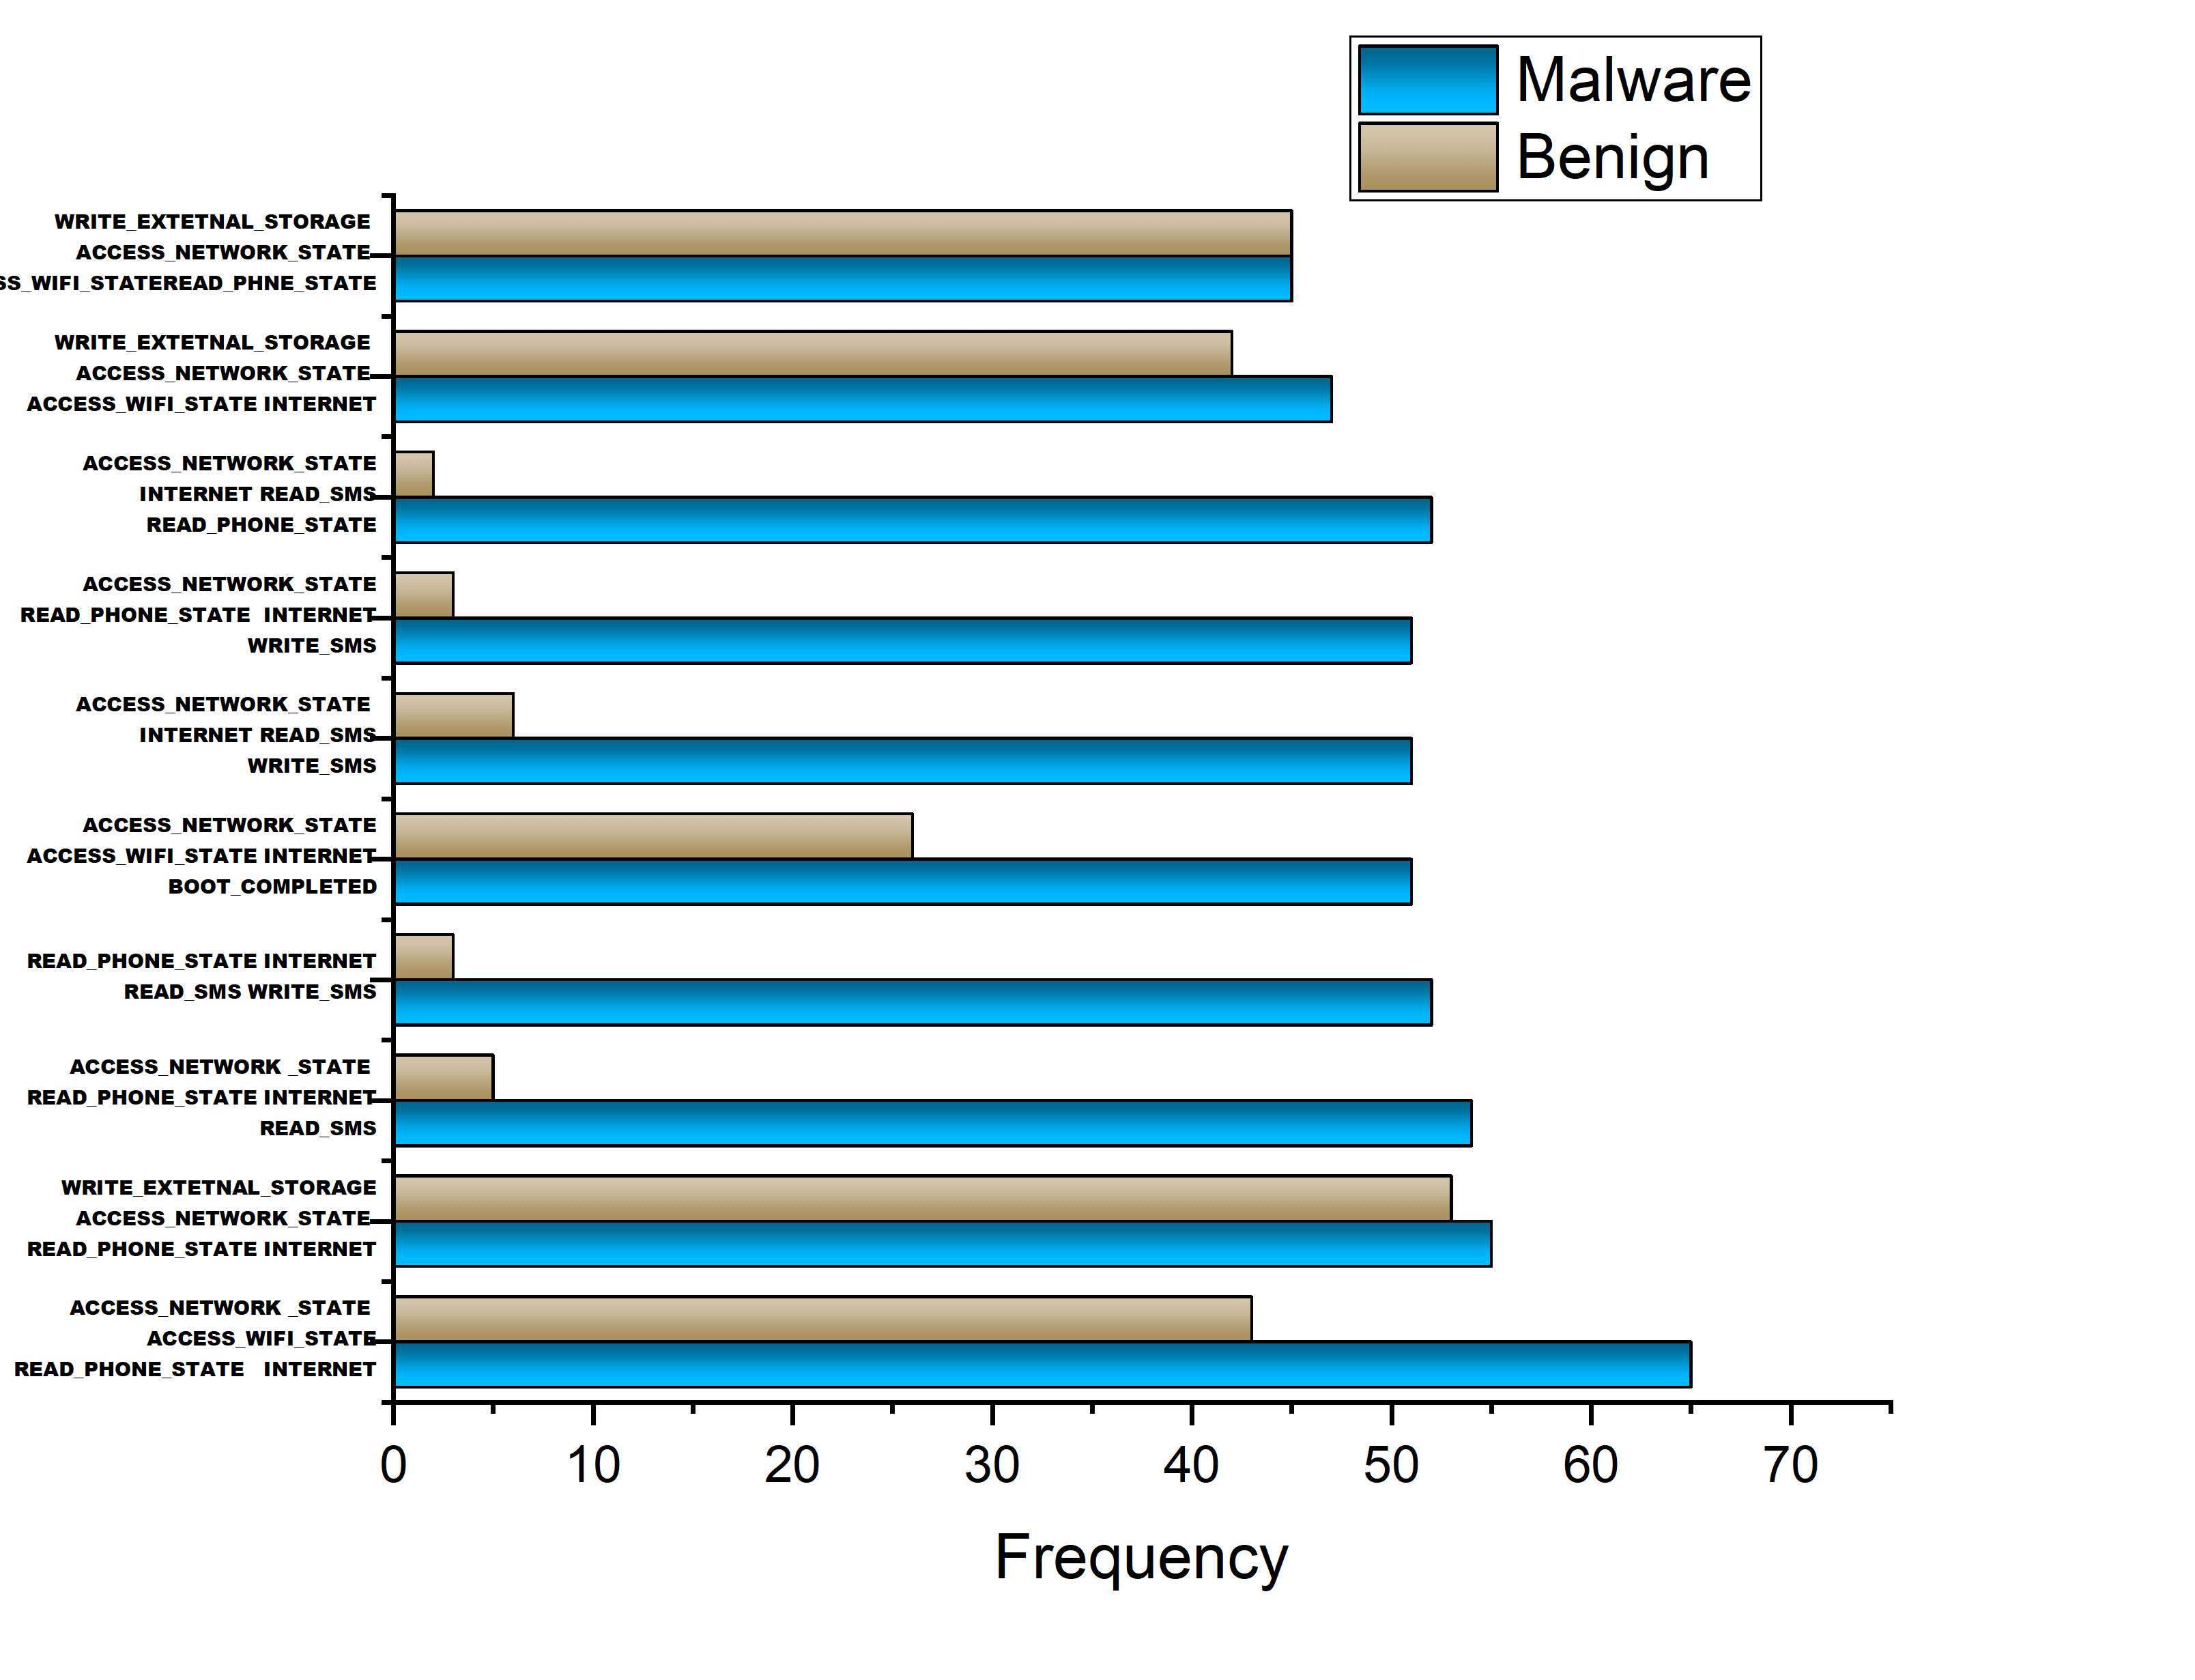
?????

Slide 48
Experiment and Results: Permission Ranking
Permission Patterns | Benign | Malware
Common Android request permission
INTERNET, READ_PHONE_STATE | 31.21 | 93.078
READ_PHONE_STATE | 31.87 | 93.4
READ_PHONE_STATE, ACCESS_WIFI_STATE | 2.36 | 63.08
INTERNET, ACCESS_WIFI_STATE | 5.05 | 63.49
ACCESS_WIFI_STATE | 5.22 | 63.49
ACCESS_NETWORK_STATE, ACCESS_WIFI_STATE | 3.99 | 60.31
READ_PHONE_STATE, ACCESS_NETWORK_STATE | 24.21 | 79.05
INTERNET, READ_PHONE_STATE, ACCESS_NETWORK_STATE | 24.21 | 78.97
INTERNET, WRITE_EXTERNAL_STORAGE, READ_PHONE_STATE | 13.28 | 65.44
WRITE_EXTERNAL_STORAGE, READ_PHONE_STATE | 13.37 | 65.53
Common Android Runtime Permissions
INTERNET, READ_PHONE_STATE | 29.9 | 91.52
READ_PHONE_STATE | 30.32 | 91.69
INTERNET, READ_PHONE_STATE, ACCESS_NETWORK_STATE | 26.36 | 77.18
READ_PHONE_STATE, ACCESS_NETWORK_STATE | 23.63 | 77.18
INTERNET, READ_PHONE_STATE, VIBRATE | 21.68 | 65.12
READ_PHONE_STATE,VIBRATE | 21.92 | 65.28
READ_PHONE_STATE, READ_LOGS | 5.38 | 46.86
READ_LOGS | 6.93 | 47.6
INTERNET, READ_LOGS | 6.85 | 6.85

Slide 49
Experiment and Results: Permission Ranking
Permission Patterns | Benign | Malware
Unique Android request permission
READ_PHONE_STATE, WRITE_SMS | 0 | 50.94
INTERNET, READ_PHONE_STATE, ACCESS_WIFI_STATE | 0 | 63.09
INTERNET, ACCESS_NETWORK_STATE, ACCESS_WIFI_STATE | 0 | 60.31
ACCESS_NETWORK_STATE, WRITE_SMS | 0 | 49.64
INTERNET, RECEIVE_BOOT_COMPLETED | 0 | 44.75
WRITE_EXTERNAL_STORAGE, ACCESS_NETWORK_STATE, ACCESS_WIFI_STATE | 0 | 54.53
READ_PHONE_STATE, RECEIVE_BOOT_COMPLETED | 0 | 43.12
INTERNET, SEND_SMS | 0 | 43.12
ACCESS_NETWORK_STATE, RECEIVE_BOOT_COMPLETED | 0 | 51.68
RECEIVE_BOOT_COMPLETED, ACCESS_WIFI_STATE | 0 | 42.63
Unique Android Runtime Permissions
INTERNET, READ_PHONE_STATE, ACCESS_NETWORK_STATE, VIBRATE | 0 | 55.42
INTERNET, READ_PHONE_STATE, READ_LOGS | 0 | 46.87
INTERNET, ACCESS_NETWORK_STATE, READ_LOGS | 0 | 43.2
READ_PHONE_STATE, ACCESS_NETWORK_STATE, READ_LOGS | 0 | 43.2
INTERNET, VIBRATE, READ_LOGS | 0 | 41.49
READ_PHONE_STATE, VIBRATE, READ_LOGS | 0 | 41.33
ACCESS_NETWORK_STATE, VIBRATE, READ_LOGS | 0 | 38.55
INTERNET, ACCESS_FINE_LOCATION, READ_PHONE_STATE, VIBRATE | 0 | 34.23
INTERNET, SEND_SMS | 0 | 33.58
INTERNET, ACCESS_FINE_LOCATION, READ_LOGS | 0 | 28.45

Slide 50
Experiment and Results: Association Rule Mining
Association Rule Mining (TOP 22 Permission)
ACCESS_WIFI_STATE | SEND_SMS
READ_LOGS | READ_CALL_LOG
CAMERA | DISABLE_KEYGUARD
CHANGE_NETWORK_STATE | RESTART_PACKAGES
WRITE_APN_SETTINGS | SET_WALLPAPER
CHANGE_WIFI_STATE | INSTALL_PACKAGES
READ_CONTACTS | WRITE_CONTACTS
READ_EXTERNAL_STORAGE | GET_TASKS
READ_HISTORY_BOOKMARKS | ACCESS_WIFI_STATE
WRITE_APN_SETTINGS | SYSTEM_ALERT_WINDOW
WRITE_SETTINGS | RECEIVE_BOOT_COMPLETED

Slide 51
Experiment and Results
Experiment and Results: Classifier Accuracy
Results: Classifier Accuracy
Alogrthim | TPR | FPR | ACC
NB | 0.979 | 0.150 | 0.934
J48 | 0.984 | 0.074 | 0.964
RF | 0.992 | 0.059 | 0.974
IRF | 0.995 | 0.046 | 0.981

Slide 52
Experiment and Results
Results: Classifier Accuracy
NB
J48
RF

Slide 53
Experiment and Results: TPR and FPR
Results: TPR and FPR

Slide 54
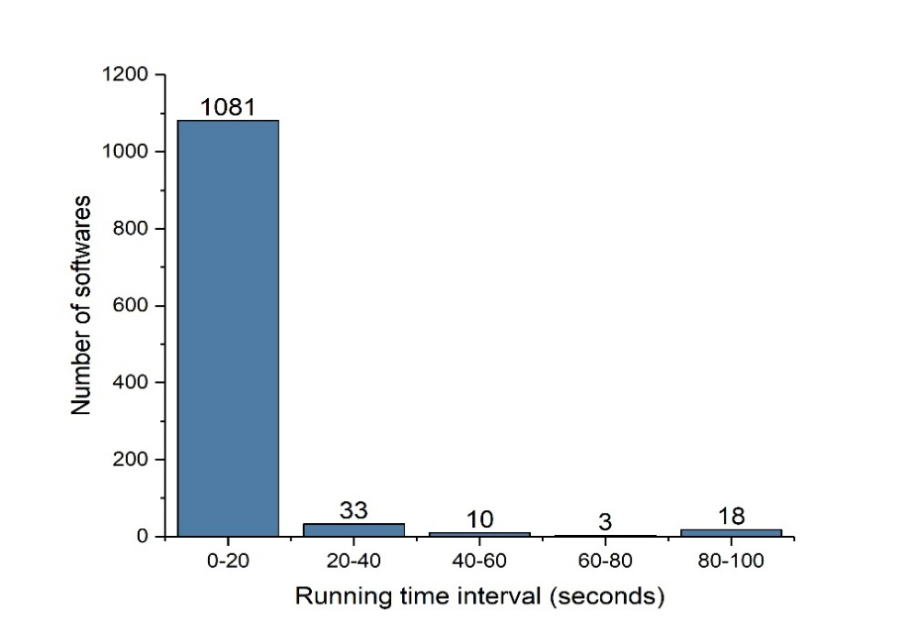
Experiment and Results: Run Time Interval
Results: Run Time Accuracy

Slide 55
Compared with Other Methods
Compared with Other Methods
Wang et al.^{[57]}which uses the ranking based approach, but it only identifies the high-risk permissions and ignores the low-risk permissions.
We focused on the low-risk as well as high-risk permissions.
Our approach is more efficient than DREBIN when combining permission. Also, the Random Forest algorithm was used to classify malware datasets. It is a little challenging to enhance DREBIN and Random Forest.

Slide 56
Summary
The permission mechanism of the Android platform restricted the access to the applications. Permission can be utilized as elements of Android applications to detect benign apps and malware apps.
However, our work reduced the number of permission for maintaining accuracy and high effectiveness.
In this work, Firstly, we adopted three data mining techniques 1) Permission Ranking, 2) similarity-based Permission feature selection, and 3) association rule for permission mining.
The permission ranking analysis and similarity-based permission are used to rank the permissions based on their risk and to collect the subsets of permissions
association rule for permission mining discovers meaningful relationships between the permissions.
Secondly, we improve the accuracy of the random forest algorithm for permission induced malware detection.

Slide 57
Summary
The permission mechanism of the Android platform restricted the access to the applications. Permission can be utilized as elements of Android applications to detect benign apps and malware apps
However, our work reduced the number of permission for maintaining accuracy and high effectiveness

Slide 58
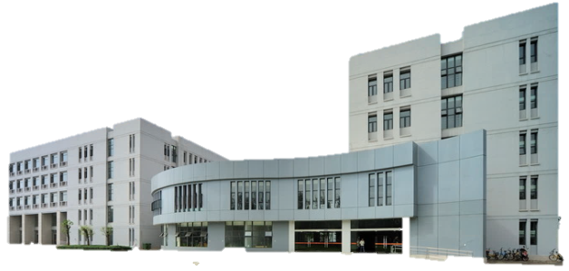
List of Publications and scientific contributions

Slide 59


sci journal Publications
SCI JOURNAL PUBLICATIONS
[1] Rajesh Kumar, Xiaosong Zhang, WenYong Wang et. al
A Multimodal Malware Detection Technique for Android IoT Devices Using Various Features by combining machine learning and blockchain technology.
[2] Rajesh Kumar, Xiaosong Zhang, Riaz Khan and Abubakar Sharif
Research on data mining of Permission-Induced Risk for Android IoT Devices.
[3] JAMALI ZAKRIA , JINGYE CAI, JIANHUA DENG, MUHAMMAD UMAR AFTAB, MUHAMMAD SADDAM KHOKHAR, RAJESH KUMAR
Efficient and Deep Vehicle Re-Identification using Multi-Level Feature Extraction.
An Adaptive Multi-Layer Botnet Detection Technique Using Machine Learning Classifiers
[4] RIAZ ULLAH KHAN, Mamoun Alazab, XIAOSONG ZHANG, ABUBACKAR SHARIF, RAJESH KUMAR
IEEE Access, 2019 (Impact factor =3.557, rank 2)
Applied Sciences-Basel (impact factor =1.68, Rank 3)
Applied Sciences-Basel (impact factor =1.68, Rank 3)
Applied Sciences-Basel (impact factor =1.68, Rank 3)

Slide 60
sci journal Publications
SCI JOURNAL PUBLICATIONS
[5] 5. ABIDA SHARIF, JIAN PING LI, SALEEM, ASIM MUHAMMAD, TANZILA SABA, RAJESH KUMAR.
Efficient Hybrid Clustering Scheme for Data Delivery using Internet of Things enabled Vehicular Ad Hoc Networks in Smart City Traffic Congestion.u have DNS server information
Journal of Internet Technology (impact factor =1.301, Rank 4)

Slide 61
EI journal Publications
SCI JOURNAL PUBLICATIONS
[1] Emelia Opoku Aboagye , Rajesh Kumar
Simple and Efficient Computational Intelligence Strategies for Effective Collaborative Decisions
[2] Riaz Khan, Xiaosong Zhang and Rajesh Kumar
Analysis of ResNet and GoogleNet models for malware detection
[3] Riaz Ullah Khan, Rajesh Kumar, Nawsher Khan, Xiaosong Zhang, and Ijaz Ahad
Optimizing a Deep Learning Model in order to have a Robust Neural Network Topology
Future Internet, Volume 11, Issue 1
Journal of Computer Virology and Hacking Techniques (2018)”
2018 International Journal of Modeling and Optimization (IJM0)

Slide 62
Conference Publications
SCI JOURNAL PUBLICATIONS
[2] RAJESH KUMAR, ZHANG XIAOSONG, RIAZ ULLAH KHAN, JAY KUMAR ,IJAZ AHAD.
Effective and Explainable Detection of Android Malware based on Machine Learning Algorithms.
[3] RAJESH KUMAR, ZHANG XIAOSONG, HUSSAIN AHMAD TARIQ, RIAZ ULLAH KHAN.
MALICIOUS URL DETECTION USING MULTI-LAYER FILTERING MODEL
International Conference on Computing and Artificial Intelligence (ICCAI 2018)
The 14th International Computer Conference on Wavelet Active Media Technology and Information Processing (2017)
[1] RAJESH KUMAR, ZHANG XIAOSONG, RIAZ ULLAH KHAN, IJAZ AHAD, JAY KUMAR.
Malicious Code Detection based on Image Processing Using Deep Learning.
International Conference on Computing and Artificial Intelligence (ICCAI 2018)

Slide 63
Conference Publications
SCI JOURNAL PUBLICATIONS
[5] Emelia Opoku Aboagye, Gee C. James, Gao Jianbin, RAJESH KUMAR, RIAZ ULLAH KHAN.
Probabilistic Time Context FRAMEWORK for Big DATA COLLABORATIVE Recommendation
[6] RIAZ ULLAH KHAN, XIAOSONG ZHANG, RAJESH KUMAR, IJAZ AHAD, JAY KUMAR.
Evaluating the Performance of ResNet Model Based on Image Recognition
“International Conference on Computing and Artificial Intelligence (ICCAI 2018)
International Conference on Computing and Artificial Intelligence (ICCAI 2018)
[4] EMELIA OPOKU ABOAGYE, GEE C.JAMES, RAJESH KUMAR.
Evaluating The Perfomance of Deep Neural Networks For Health Decision Making.
8th International Congress of Information and Communication Technology (ICICT-2018)

Slide 64
Conference Publications
SCI JOURNAL PUBLICATIONS
[8] ABIDA, JIANPING LI, MUDASSIR KHALIL, RAJESH KUMAR, MUHAMMAD IRFAN SHARIF.
Internet of things—smart traffic management system for smart cities using big data analytics
[9] RIAZ ULLAH KHAN, RAJESH KUMAR, XIAOSONG ZHANG, MAMOUN ALAZEB.
Internet A Hybrid Technique To Detect Botnets, Based on P2P Traffic Similarity
The 14th International Computer Conference on Wavelet Active Media Technology and Information Processing (2017)
International Conferences on Cyber Security and Communication Systems (ICCSCS2018)
[7] RIAZ ULLAH KHAN, XIAOSONG ZHANG, RAJESH KUMAR, HUSSAIN AHMAD TARIQ
ResNet model for Malicious Code Detection
The 14th International Computer Conference on Wavelet Active Media Technology and Information Processing (2017)

Slide 65
Conference Publications
SCI JOURNAL PUBLICATIONS
[10] RIAZ ULLAH KHAN, , XIAOSONG ZHANG, MAMOUN ALAZEB, RAJESH KUMAR
An Improved Convolutional Neural Network model for Intrusion Detection in Networks
International Conferences on Cyber Security and Communication Systems (ICCSCS2018)

Slide 66
Acknowledgement
I would like to thank my professor Xiaosong Zhang for accepting me in his research group, and his continuous support and encouragement
I also would like to thanks my parents for their prayers and encouragement through my PhD tenure
Finally, I would to thanks my friends, labmates and UESTC staff for their help and support in these years.
Xiaosong Zhang
my friends, labmates and UESTC staff
my parents

Slide 67
Conclusion and Future Work

Slide 68
This research work proposes a framework that combines blockchain and machine learning for effective malware detection of Android IoT devices
Combine Blockchain and ML
Malware information stored in the blockchain history can be communicated through the network, therefore any latest malware can be detected effectively
Stored in the blockchain
Permission
The permission ranking analysis and similarity-based permission are used to rank the permissions based on their risk and to collect the subsets of permissions
RESULTS
The experimental outcomes demonstrate high proficiency of the accuracy for malware detection, which is pivotal for android apps aiming for secure data exchange between IoT devices

Slide 69
Future Work
To develop a framework based on the deep neural network to combine static and dynamic analysis for malware detection using blockchain
There is need to modify LSTM algorithm for effective malware detection
To develop a malware detection method using behavior features in network traffic for Android IoT Devices
There is need to modify LSTM algorithm for effective malware detection

Slide 70


Slide 71


